Slide 1

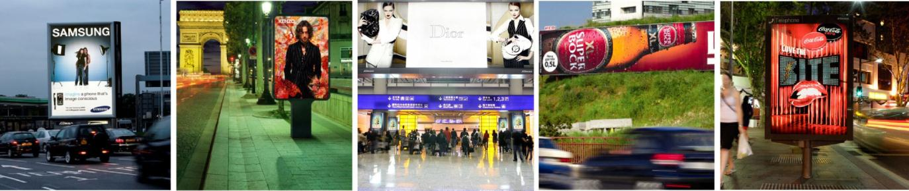
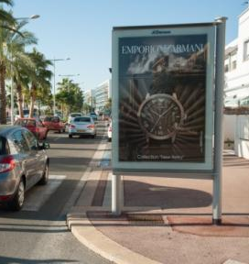

OUTDOOR RESEARCH AND INNOVATION, THE KEY FOR THE FUTURE
Albert Asséraf
EVP Strategy, Research & Marketing
JCDecaux France
Kiev - May 22, 2013

Slide 2
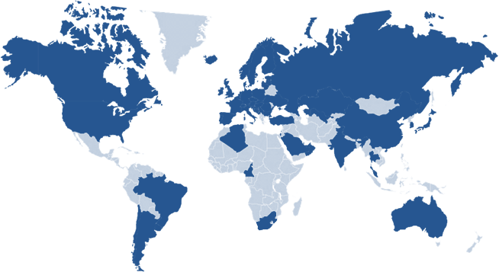
JCDecaux Group overview
Global Presence
Over 55 countries Worldwide
€ 2,623 million
2012 revenues
10,484 employees
Daily worldwide audience
of 300 million people
3,700 cities
over 10,000 inhabitants
Key figures as of December 31^{st,} 2012

Slide 3
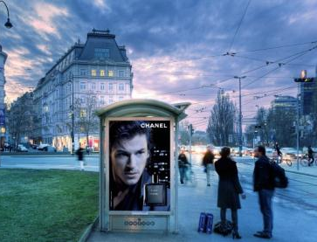
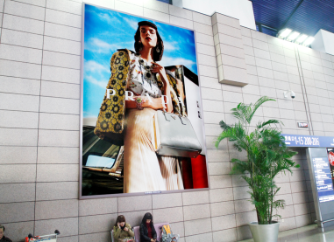
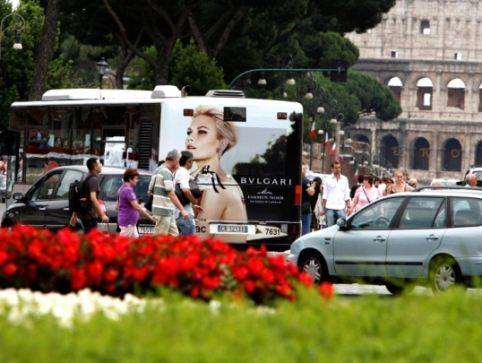
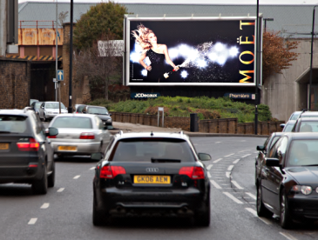

JCDecaux Group overview
Key Activities
Street Furniture
Airport Advertising
Transport Advertising
Billboards
N°1
Worldwide
N°1
Worldwide
N°1
Worldwide
N°1
in Europe
N°1 worldwide in Outdoor Advertising
and the only pure player in Outdoor advertising
Notes:
Le seul acteur « Pure player » mondial de la Communication Extérieure

Slide 4

AGENDA
OUTDOOR RESEARCH & INNOVATION
1
Understanding our environment
2
AUDIENCE RESEARCH ON THE MOVE
3
Insights on Outdoor effectiveness
4
Digital and interactivity : new frontiers

Slide 5
AGENDA
OUTDOOR RESEARCH & INNOVATION
1
Understanding our environment
2
AUDIENCE RESEARCH ON THE MOVE
3
Insights on Outdoor effectiveness
4
Digital and interactivity : new frontiers

Slide 6
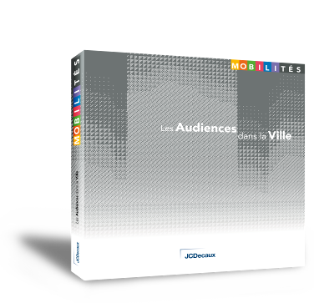
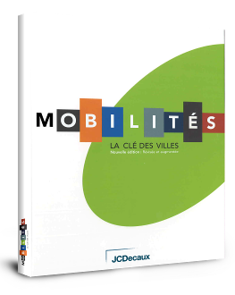

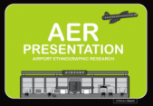
UNDERSTANDING OUR ENVIRONMENT
TO POSITION OUTDOOR AS A STRATEGIC MEDIUM
FOR BRANDS
JCDecaux : expert of cities, airports, urban trends and mobility
Cities and mobility hubs have become truly unique and strategic places to engage with consumers.
Keeping up with the way these environments change and develop as well as with shifting consumer expectations provides key insights for our media.
2006 : the City
2008 : Audiences
in the City
: Brands
in the City
& 2012 : Brands and consumers
in Airports
Notes:
As the leading operator of Outdoor in the world, it is our commitment to constantly deliver insights on our environements in order to make our medium attractive to advertisers.
We have a unique position to do this – we have developed in cities WW for close to 50 years and are a keen observer of the way cities are changing
Cities are the daily scene of people’s lives – over 50% of the world’s population in fact
Both urban and international mobility are on the rise : air travel expected to double WW by 2030
Research is a key tool to understand change and better adapt our products and services to cities’, citizens’ and brands’ expectations

Slide 7
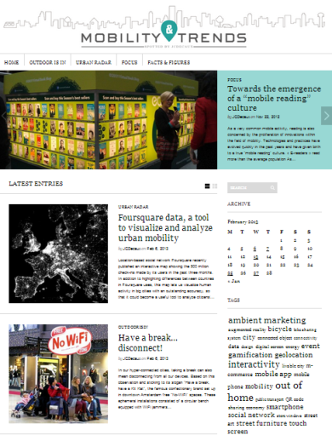
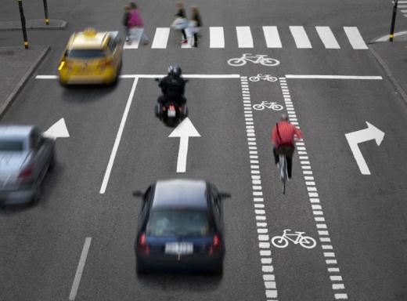
UNDERSTANDING OUR ENVIRONMENT
TO POSITION OUTDOOR AS A STRATEGIC MEDIUM
FOR BRANDS
The future of cities
Identifying trends and exploring urban creativity worldwide…
An on-going effort to understand the changes and issues shaping future cities and transport hubs everywhere in the world.
www.mobility-trends.com
Notes:
To highlight a few examples :
Trend books and an ongoing global city blog

Slide 8
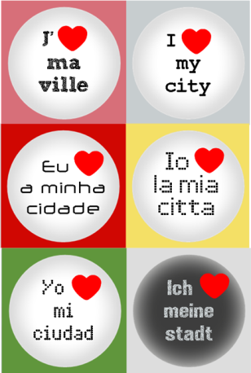

UNDERSTANDING OUR ENVIRONMENT
TO POSITION OUTDOOR AS A STRATEGIC MEDIUM
FOR BRANDS
Cities
The place to be for brands – a highly creative playground where consumers await the unexpected
94%
The city of potential
« Everything is possible and within arm’s reach in the city»
80%
The city of discovery
« I’m forever discovering something different in the city »
73%
The essential city
« I can’t stay away from the city for long »
The city I can identify with
72%
« I feel alive in the city »
Source : Urbanstories - 2009
Notes:
It is our role to show brands how cities are evolving
We also conduct qualitative research – focus groups for example, to explore

Slide 9
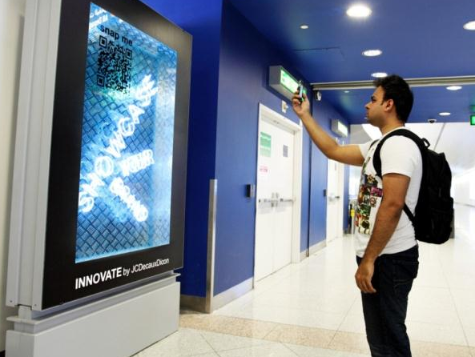

UNDERSTANDING OUR ENVIRONMENT
TO POSITION OUTDOOR AS A STRATEGIC MEDIUM
FOR BRANDS
Airports
New expectations and a positive mindset pave the way for innovative brand presence
“ 99% of the time you have time on your hands… that’s a great opportunity to provide some interaction between the brand & the consumer ”
Annie Rickard, President, Posterscope Worldwide
International Frequent Flyers
enjoy airport advertising
85%
Want more activities,
services & distractions
82%
75%
Enjoy looking at brand exhibits
Source : Airportstories World - 2012
Notes:
It is also our role to explore how specific mindsets can drive advertising effectiveness – ie. AER research in airports conducted in the UK to understand mindset at every step of the journey in an airport

Slide 10

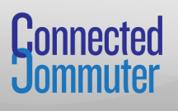
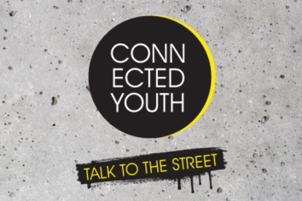
UNDERSTANDING OUR ENVIRONMENT EXPLORING OUR TARGETS’ PERCEPTIONS
AND BEHAVIOURS
Targets
Researching specific targets’ attitudes and purchasing behaviour is key to promoting Outdoor in a brand’s communication strategy.
91% buy on impulse when grocery shopping online, instore or during their daily commute.
60% of 15-24 year-olds prefer shopping instore than online
Source : JCDecaux UK – Connected Communter and Connected Youth mobile panels- 2012
Notes:
A few examples of recent research from the UK – understanding our environment also means understanding our different target populations. Even if outdoor remains a mass medium, it can reach highly mobile people in an unmatched way.
Connected commuter : a panel to understand the way daily users of urban transportation think, act, enjoy brand presence and buy products. This particular example shows how important it is for retailers to invest Outdoor in order to reach commuters while they are thinking about grocery shopping on their way home for example.
Connected youth : no, young people do not spend all their time online. In fact, they are among the most mobile target populations. Again, this is the reason why brands need to use outdoor in order to reach this specific target in an efficient way.

Slide 11
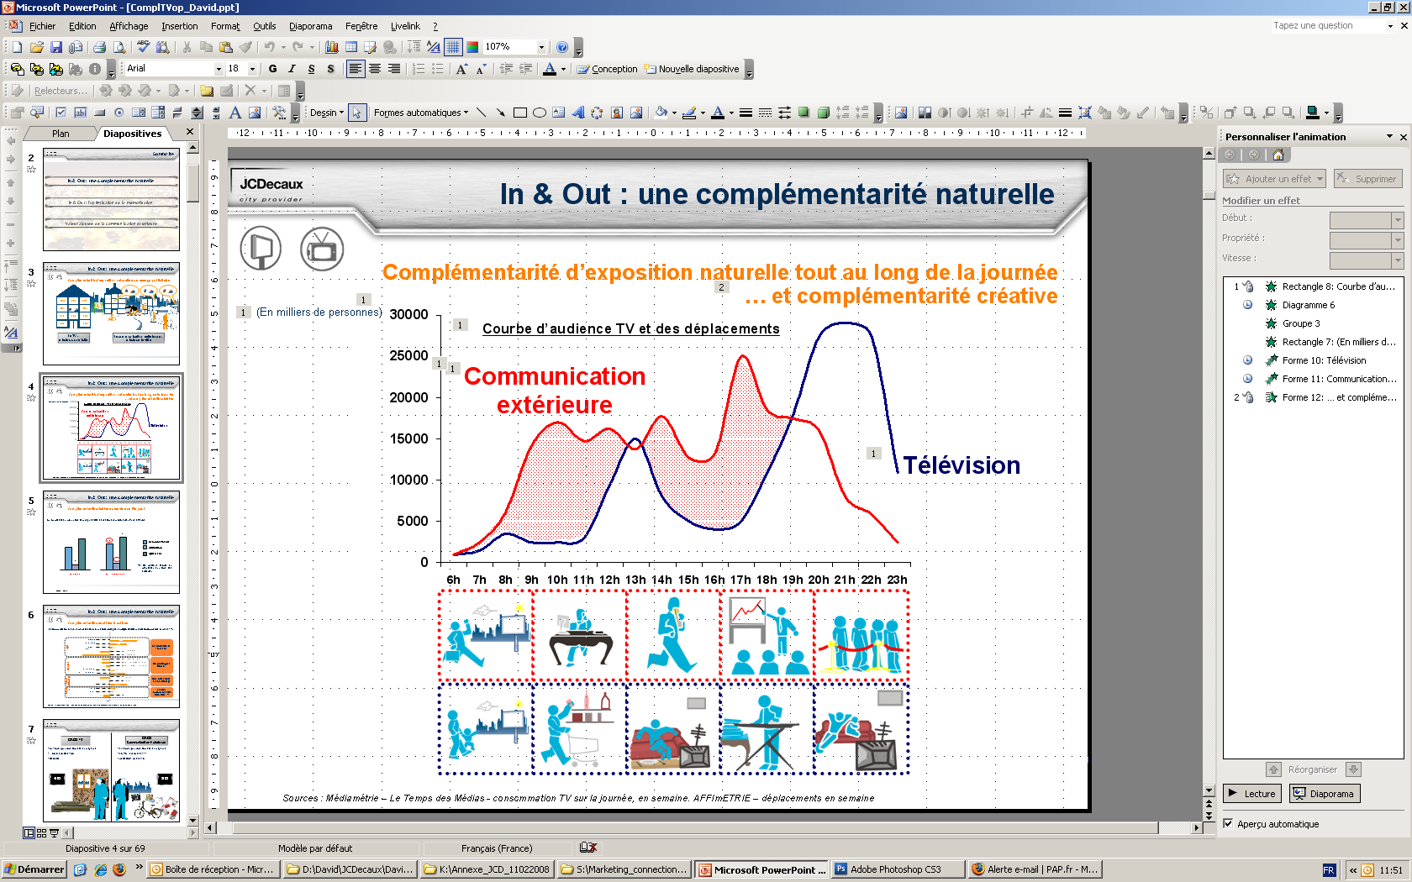
UNDERSTANDING OUR MEDIA ENVIRONMENT HOW DOES OUTDOOR INTERACT
WITH OTHER MEDIA ?
Media
In a highly fragmented media world, Outdoor is the last mass medium that can reach targets on the move… and work in synergy with other media
Thousand people
Television
(En milliers de personnes)
Outdoor
TV and Outdoor
Complementarity between the two media is evideced all day long.
Sources: 2012 Médiamétrie – Le Temps des Médias - Daily TV consumption, weekdays.
AFFIMETRIE – Weekdays out-of-home movements
Notes:
Many pieces of research have looked at the way brands can benefit from Outdoor in synergy or as a complement to other media.
This has mainly been done with TV, showing that both media work well together and that Outdoor has an important role to play in order for a brand to reach its marketing goals.

Slide 12
AGENDA
OUTDOOR RESEARCH & INNOVATION
1
Understanding our environment
2
AUDIENCE RESEARCH ON THE MOVE
3
Insights on Outdoor effectiveness
4
Digital and interactivity : new frontiers

Slide 13

OUTDOOR ADVERTISING
A SPECIAL CASE FOR RESEARCH
THE MOBILITY MEDIUM
THE LAST MASS MEDIUM
The more people are on the move, the more they are exposed to Outdoor advertising
Notes:
Unlike other media, OOH can not be turned off, zapped through or avoided. OOH provides impactful and effective presence.

Slide 14
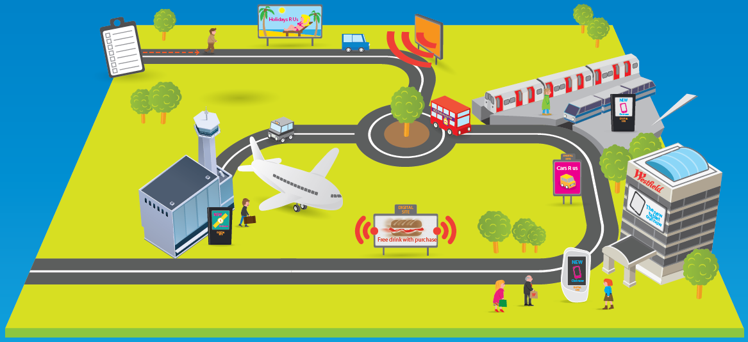
OUTDOOR ADVERTISING
A SPECIAL CASE FOR RESEARCH
THE MOBILITY MEDIUM
THE TOUGHEST CHALLENGE IN AUDIENCE RESEARCH
Moving frames
Moving audience
Outdoor & Indoor
Frames anywhere
How visible ?
Static, scrolling, or video
Notes:
The out-of-home sector presents the toughest challenge in audience research.
Those exposed to the medium are constantly moving. The advertising frames can be anywhere and everywhere – at the side of a road, inside stations or even inside trains. Some frames, such as those on buses, continually change location.
Advertising displays vary from traditional “paper and paste” to high-definition digital screens. Some frames show static posters, some are dynamic – they can scroll or show video copy.
There is no guarantee that someone passing in proximity to an advertising frame will see it. Are they travelling toward the frame? Is the frame facing the right way? Is the view obstructed? If it is dark, is the frame illuminated?
A single study will not do.
The answer is to combine a number of studies, each of which is tailored to answer specific challenges of measuring the audience for out-of-home advertising.

Slide 15


SUBSTANTIAL PROGRESS
IN LESS THAN 20 YEARS
Availability of a modern OOH industry measurement system
1990s
2013
In 2 countries
France & UK
In most significant markets
≈ 20 countries
1992
1996
Notes:
Pendant environ 15 ans, chaque pays a développé son propre système, sans référence méthodologique commune

Slide 16
SUBSTANTIAL PROGRESS
PACE OF CHANGE INCREASES
Northern Ireland
2009
Austria
2012
Great Britain
1996
Great Britain
2012
Sweden
2005
Netherlands
2011
Norway
2008
Germany
2008
Finland
2006
Ireland
2005
Netherlands
2000
Slovenia
2008
China
2008
USA
2010
Singapore
1999
Australia
2010
Up-to-date audience measurements
Industry measurements in solid progress
Notes:
1 clic pour lancer l’animation, qui déroule automatiquement jusqu’à la fin

Slide 17






OUTDOOR ACCOUNTABILITY
CONSISTENT METHODOLOGY
Since 2009, the Outdoor Industry has a globally recognised methodology, endorsed by our customers
American Association of Advertising Agencies
JCDecaux was a leading player in this initiative (we chaired the technical committee)
Notes:
JCDecaux a largement contribué au développement d’une méthodologie cohérente pour la mesure d’audience de la communication extérieure en Europe, aux États-Unis et en Asie- Pacifique.
En 2008, un Groupe de réflexion a été crée sous l’égide de l’institut de recherche international ESOMAR, avec pour objectif de mettre en œuvre des normes spécifiques à la communication extérieure (« Global Guidelines for Out Of Home Audience Measurement »).
JCDecaux est membre du comité de décision de l’ESOMAR et préside le comité technique de cet institut, dont font également partie la Fédération Internationale des Annonceurs (« World Federation of Advertisers ») et d’autres parties prenantes de l’univers de la publicité. A ce jour, seuls la télévision et Internet ont pris de telles initiatives en matière de mesure d’audience, et cette démarche démontre l’importance croissante qu’attachent les annonceurs à la communication extérieure dans leur stratégie publicitaire. La méthodologie de référence a été publiée et mise en application en 2009, ce qui a permis d’aider les marchés dans le monde à développer une véritable mesure d’audience locale permettant à la communication extérieure de rivaliser plus efficacement avec d’autres médias.
Benefits
Input of all major industry stakeholders
Clear guidance of best practice
Platform for reliable audience measurement
Proposal for standardised data formats to facilitate international planning
Meaningful and comparable ROI measures possible

Slide 18
















OUTDOOR ACCOUNTABILITY
CONSISTENT METHODOLOGY
UK
Ireland
Germany
Norway
Belgium
Spain
USA
France
Italy
Sweden
Denmark
Poland
Slovenia
Australia
Switzerland
Finland
Czech Rep.
Austria
Holland
China
In Progress
GEOMEX
Notes:
des noms différents, mais des bases méthodologiques communes pour toutes ces études.

Slide 19

GUIDELINES RECOMMEND
AN INTEGRATED APPROACH
Visibility Study
Travel
Survey
Integrated Approach
Panel Classification
Traffic
Weighting

Slide 20
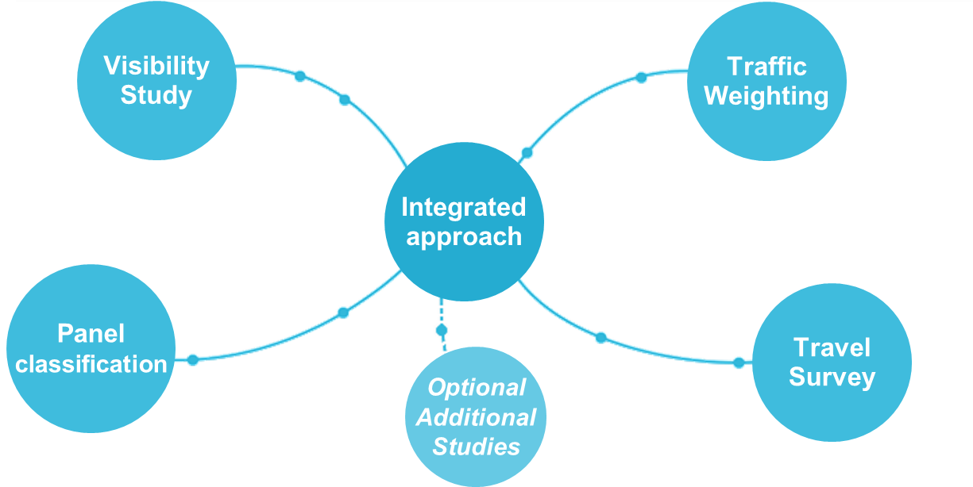
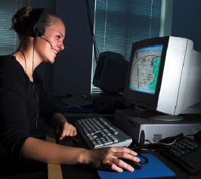
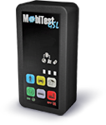

GUIDELINES RECOMMEND
AN INTEGRATED APPROACH
Travel Survey
Purpose ➔ establish the numbers and demographic profile of people passing panels to calculate reach and frequency
GeoCATI
GPS
AND / OR
Lower cost for extensive geographic coverage
Increasingly accurate
(passive measure)
Used in the Netherlands, Germany, Switzerland, Italy, Austria, the UK and soon in Turkey
Notes:
Usage du GPS, se développe surtout depuis 2011.

Slide 21



GUIDELINES RECOMMEND
AN INTEGRATED APPROACH
Traffic
Weighting
Purpose ➔ affix audience numbers and complement the travel survey with traffic flows in pathways not covered by the survey
Dedicated observations
data from Local Authorities & Transport Companies
+
RISING TRENDS
MALL
Integration of indoor environments
Traffic Intensity Models to simulate traffic flows where no data is available

Slide 22



GUIDELINES RECOMMEND
AN INTEGRATED APPROACH
Panel classification
Purpose ➔ accurate description of the type & sitting of every display frame
Precise location
Situation (roadside, retail…)
Static or changing with timing
Illumination
Angle to primary travel path
Distance & height from road
Obstructions > 10%
Clutter of the visual environment
Statistical modelling
of contacts
& Visibility adjustment
Notes:
95E5FA9F7A7DD947C76D924697

Slide 23
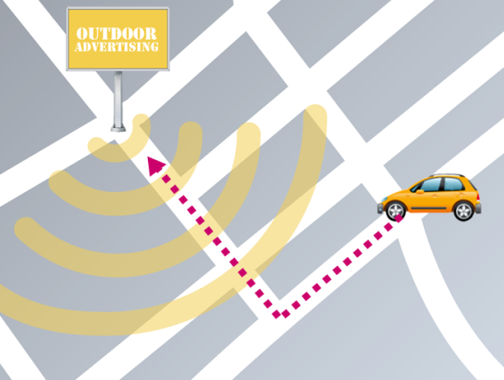

GUIDELINES RECOMMEND
AN INTEGRATED APPROACH
Visibility Study
Purpose ➔ more realistic contact definition
Contact definition = increasing accuracy over time
Flow : number of passages past a panel
Opportunity To See : number of passages that results in a possible contact with the panel
Visibility Adjusted Contact : number of passages that results in a probable contact with the ad
Eye movement research
➔ Visibility algorithms
Notes:
In principal visibility adjustment may take several forms
In practice however there is a growing global uniformity around eye movement research
Visibility algorithms are developed based upon the prominence of advertising panels within the environment

Slide 24

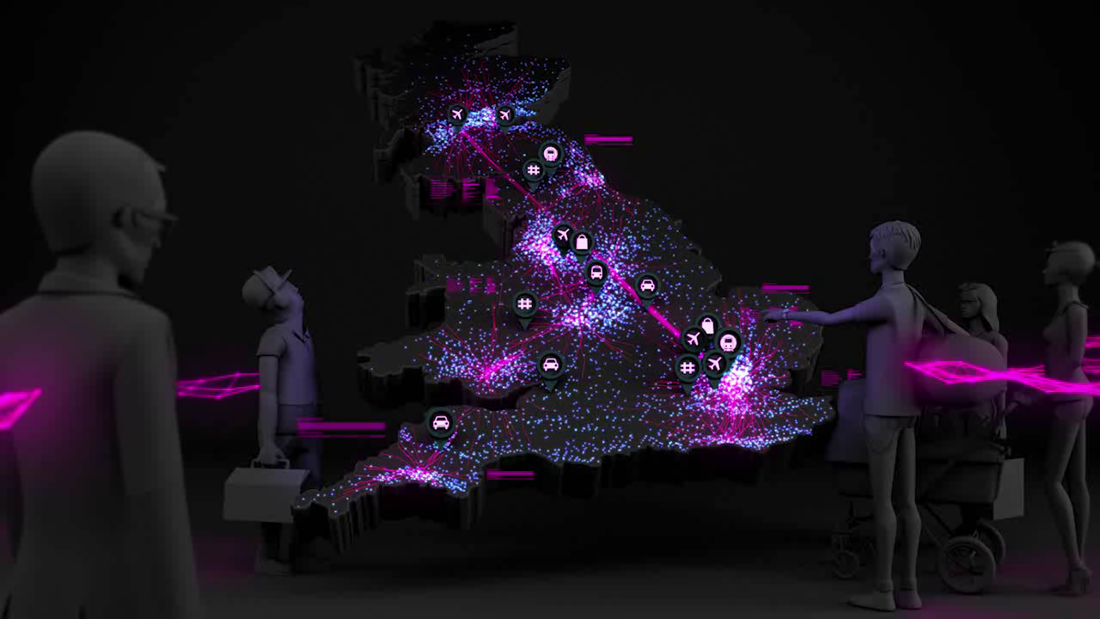

Slide 25

WHY AUDIENCE MEASUREMENT MATTERS
Planners are moving from buying media to buying audience
OOH is unlike other media in that
the medium is the message
Outdoor is now well placed to provide relevant comparative data for
Multi Media Planning
Notes:
OOH planning, trading and valuation based on audience is an entry level requirement
Media decisions are based upon an understanding of audience
Planners are moving from buying media to buying audience
Outdoor is now well placed to provide relevant comparative data
For Outdoor to realise its true value, we need to speak the same language as our customers.
Multi Media Planning
Media auditing/Procurement
Cost (per point)
Econometric Modelling/ROI
➔ The language used in describing the outdoor offer is significant

Slide 26
AGENDA
OUTDOOR RESEARCH & INNOVATION
1
Understanding our environment
2
AUDIENCE RESEARCH ON THE MOVE
3
Insights on Outdoor effectiveness
4
Digital and interactivity : new frontiers

Slide 27
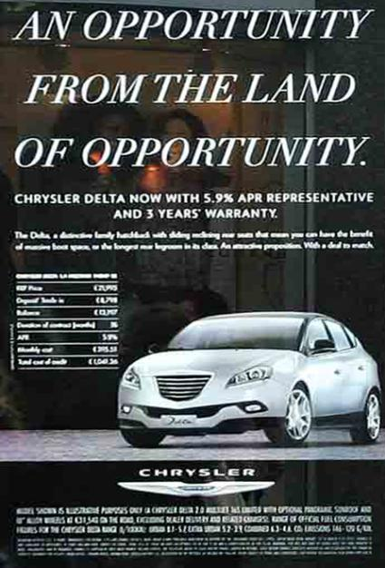



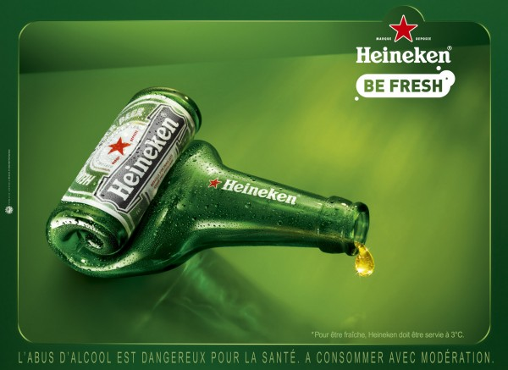
CREATIVITY IS KEY !
Notes:
FIAT Chrysler Juin 2011 à San Francisco
Société Générale → Algérie

Slide 28


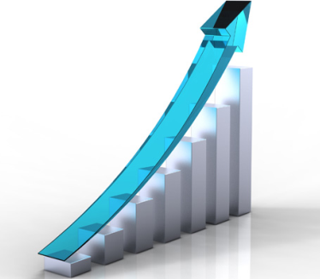
APPROACHING OUTDOOR EFFECTIVENESS
Outdoor effectiveness can be approached along 3 dimensions:
Creative execution
Impact and brand effects
Sales and R.O.I.
Notes:
The right message, the right impact, to develop brand perceptions and sales

Slide 29

ENSURING OPTIMAL VISIBILITY OF CREATIVES THE FIRST STEP TOWARD EFFECTIVENESS
Créaction is a new creative preview application available in 8 countries. Based on the 3D full HD rendering of a city, it’s the perfect tool to:
  Optimize Outdoor creatives in real-life settings
  Enhance attraction and differentiation
  Improve impact through increased contrast
Notes:
In France alone, over 250 CreAction tests every year
To date available in 8 countries and is quickly expanding

Slide 30
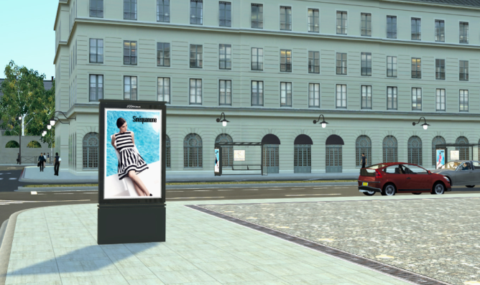
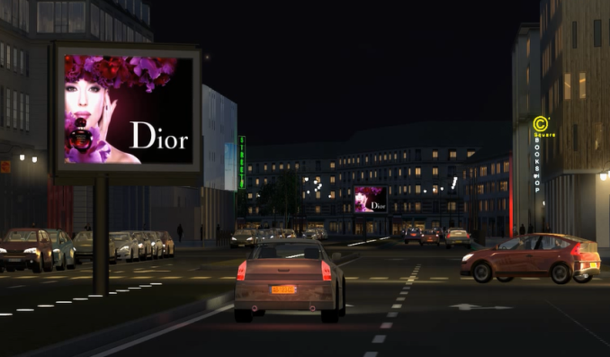
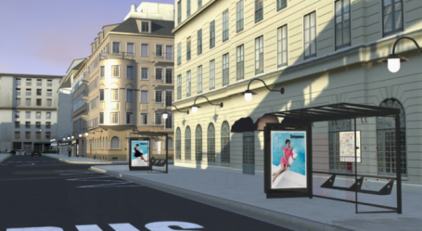
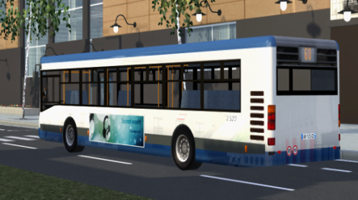
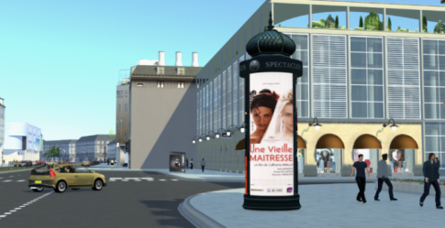
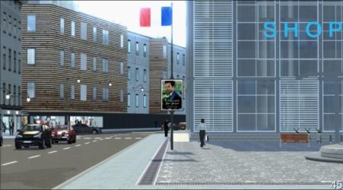
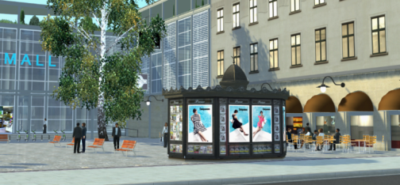
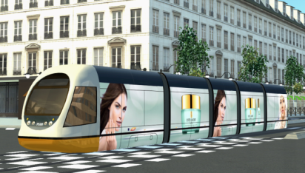
CREACTION TOOL
MUPI
Free-Standing
Bus Shelter
Bus
Column
Flagpole
Kiosk
Tramway

Slide 31


CREACTION TOOL
Giorgio Armani: the impact & readability have been improved
Before
After

Slide 32




OVER 10 YEARS’ EXPERIENCE TO DELIVER GUIDELINES FOR IMPACTFUL CAMPAIGNS
Focus on a simple and easily understandable message
Easily understandable message
Message too complex to be decoded in 5 seconds

Slide 33


GUIDELINES FOR IMPACTFUL CAMPAIGNS
Limit the use of different messages inside a single creative
A clear and well highlighted offer
The offer is “pulled” under all the other components of the creative. It won’t stand out .
Notes:
Amazon : transport UK_ Eurostar_Digital

Slide 34


GUIDELINES FOR IMPACTFUL CAMPAIGNS
Be legible : use short, easily readable claims
A short and impacting claim
Readability issue

Slide 35
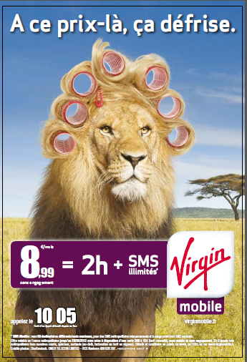
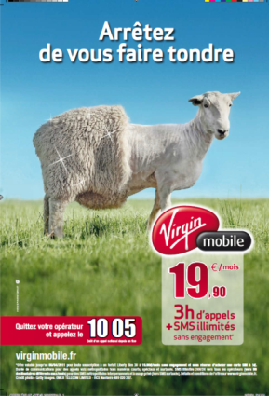


GUIDELINES FOR IMPACTFUL CAMPAIGNS
Use repetition in order to enhance recall and brand attribution
January 2011
April 2011
November 2011
June 2012

Slide 36
APPROACHING OUTDOOR EFFECTIVENESS
Outdoor effectiveness can be approached along 3 dimensions:
Creative execution
Impact and brand effects
Sales and R.O.I.
Notes:
The right message, the right impact, to develop brand perceptions and sales

Slide 37



MEASURING CAMPAIGN IMPACT AND BRAND BENEFITS
Post- campaign research to guide our clients and their agencies and evaluate actual effects of their Outdoor spend.
In France for example, we carry out over 80 post-tests every year for our clients on a wide variety of sectors:

Slide 38

CAMPAIGN POST-TESTING
A post test enables to answer the following questions:
Does the creative catch the consumer’s attention ?
Is the campaign changing consumers’ behaviors ?
Is the campaign well linked to the brand ?
What are the creative routes asperities?
Is the creative route appreciated ?
What are the feelings triggered by this communication?

Slide 39

POST-TEST EXAMPLE
LANCÔME
A well-liked creative showing strong impact and excellent brand attribution
Lancôme
La vie est belle
Norm (benchmark)
Recall
69%
32%
Brand attribution
36%
13%
Likeability
78%
71%
Source: Ipsos
Notes:
Norm taking account the level of budget and the sector.

Slide 40
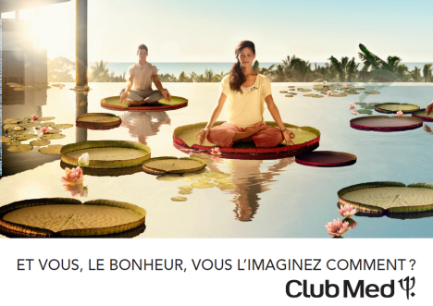
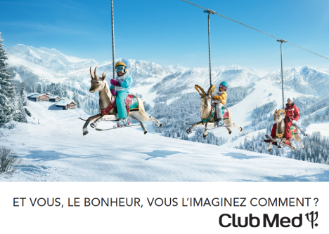
BEYOND IMPACT
MEASURING BRAND BENEFITS
This Club Med campaign improved key brand dimensions :
87% consider Club Med a premium brand
92% say the campaign succeeds in showing the large variety of destinations
90% have a good opinion of Club Med through these ads

Slide 41
APPROACHING OUTDOOR EFFECTIVENESS
Outdoor effectiveness can be approached along 3 dimensions:
Creative execution
Impact and brand effects
Sales and R.O.I.
Notes:
The right message, the right impact, to develop brand perceptions and sales

Slide 42

THE ULTIMATE GOAL
MEASURING RETURN ON ACTUAL SALES
80% of Fmcg campaigns result in short-term sales uplifts
Through a variety of effects and on different types of campaigns :
Product launches or on-going sales support
Outdoor only or multimedia campaigns
By recruiting new customers or building stronger brand loyalty
Source: MarketingScan – research conducted in France

Slide 43
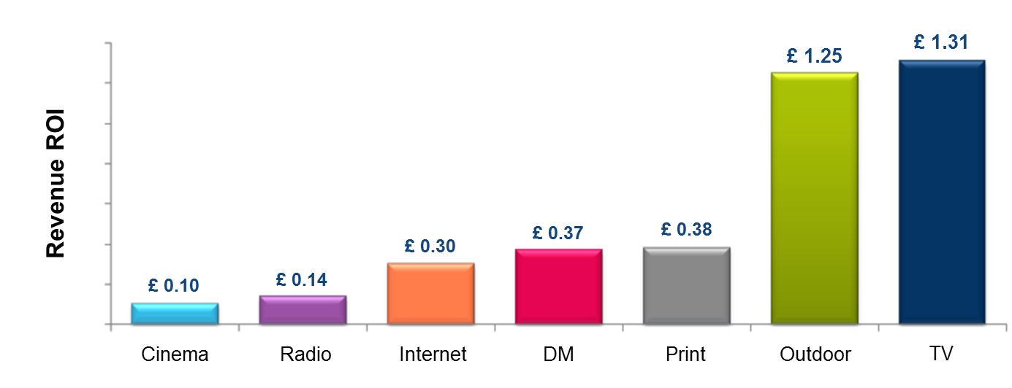
A STEP FURTHER
MEASURING OUTDOOR R.O.I.
According to research conducted in the UK, for Fmcg brands, Outdoor is the 2nd best performing medium in terms of R.O.I.
ROI based on cost of media space
Sample: Brand Science UK - All FMCG Results Vault studies (2009) -
with and without measured Outdoor RROI
Notes:
When ROI is based on the cost of the media space only (i.e. excluding production costs), TV is slightly more efficient than outdoor.
BUT
Measuring R.O.I. remains complex : such research needs to be extended and reproduced to gain finer understanding of the mechanisms at work.

Slide 44
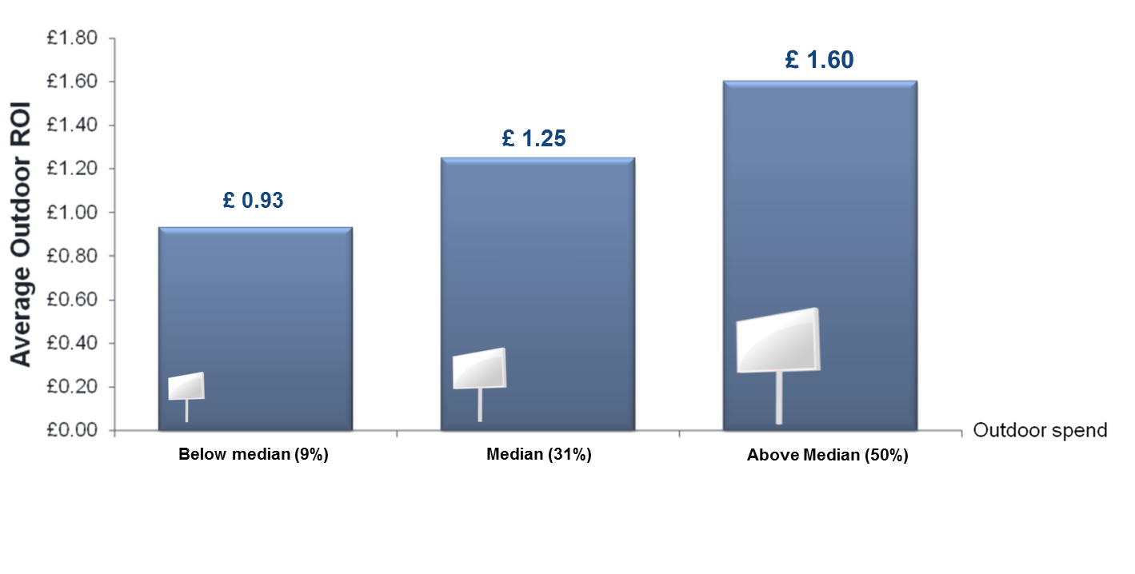
A STEP FURTHER
MEASURING OUTDOOR R.O.I.
FMCG: Outdoor ROI increases with proportion of spend
Outdoor ROI vs
Outdoor Spend
Sample: Brand Science UK - All FMCG Results Vault studies (2009) -
with and without measured Outdoor RROI

Slide 45
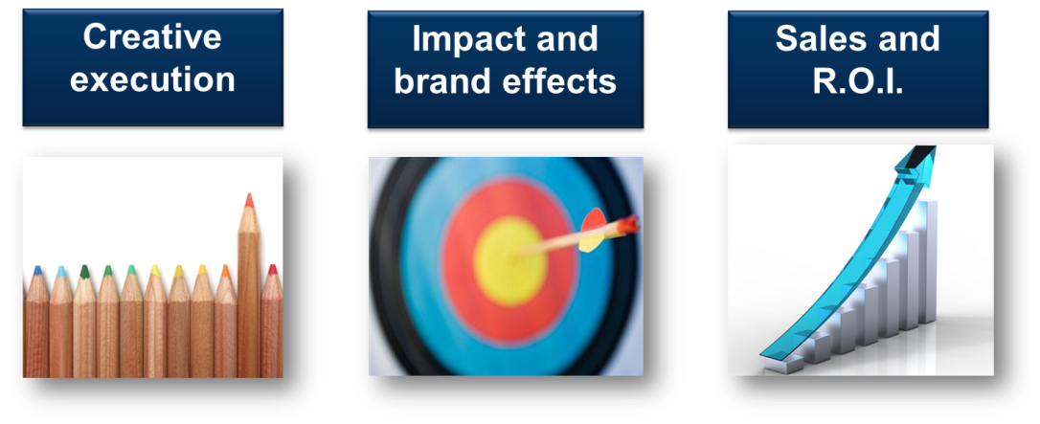
APPROACHING OUTDOOR EFFECTIVENESS
An optimized creative for an impactful campaign capable of reaching the brand’s objectives in terms of image and increased sales
Notes:
The right message, the right impact, to develop brand perceptions and sales

Slide 46
AGENDA
OUTDOOR RESEARCH & INNOVATION
1
Understanding our environment
2
AUDIENCE RESEARCH ON THE MOVE
3
Insights on Outdoor effectiveness
4
Digital and interactivity : new frontiers

Slide 47
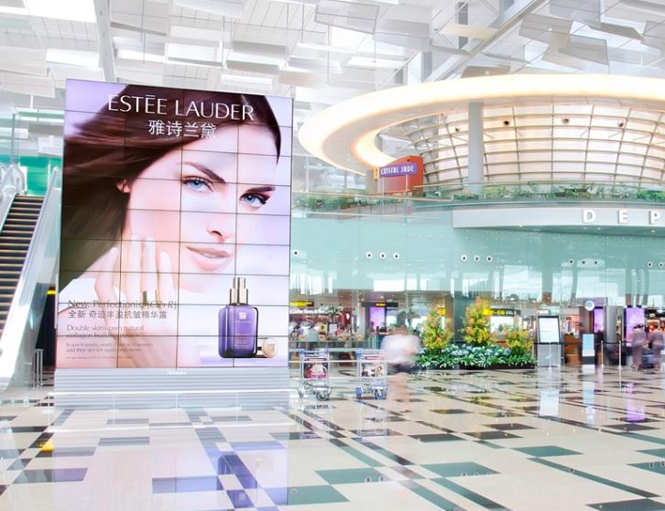
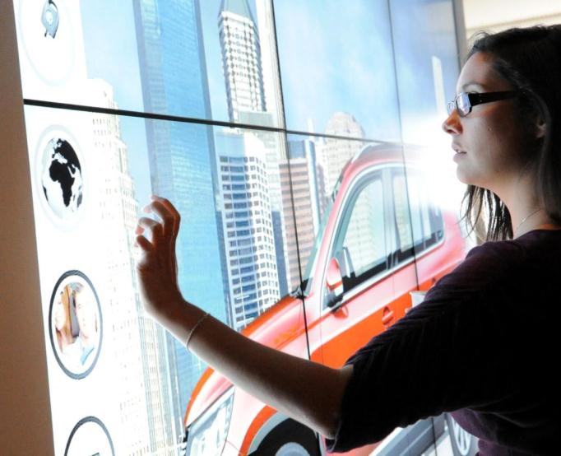
OUTDOOR INNOVATION
2 DRIVERS FOR THE FUTURE
Outdoor will strongly benefit from the digital revolution, opening new opportunities to make our media even more strategic for brands.
digital
interactivity
Estée Lauder, Singapore Changi Airport
Notes:
Out-Of-Home, among which airports, will strongly benefit from the digital revolution
Far from stifling / diminishing our media, digital and mobile represent exciting opportunities.
Two key drivers will reinforce our media and make it more engaging in the coming years.
Digital, of course, and some Transport environments are already mainly digital – it’s the case in some airports like Aéroports de Paris, or metro stations in Shanghai…
Interactivity, to make advertising messages even richer, to add another dimension, to enable consumers to engage with brands.
NEXT SLIDE : the many assets of digital

Slide 48
OUTDOOR INNOVATION
2 DRIVERS FOR THE FUTURE
Outdoor will strongly benefit from the digital revolution, opening new opportunities to make our media even more strategic for brands.
digital
interactivity
Estée Lauder, Singapore Changi Airport
Notes:
Out-Of-Home, among which airports, will strongly benefit from the digital revolution
Far from stifling / diminishing our media, digital and mobile represent exciting opportunities.
Two key drivers will reinforce our media and make it more engaging in the coming years.
Digital, of course, and some Transport environments are already mainly digital – it’s the case in some airports like Aéroports de Paris, or metro stations in Shanghai…
Interactivity, to make advertising messages even richer, to add another dimension, to enable consumers to engage with brands.
NEXT SLIDE : the many assets of digital

Slide 49
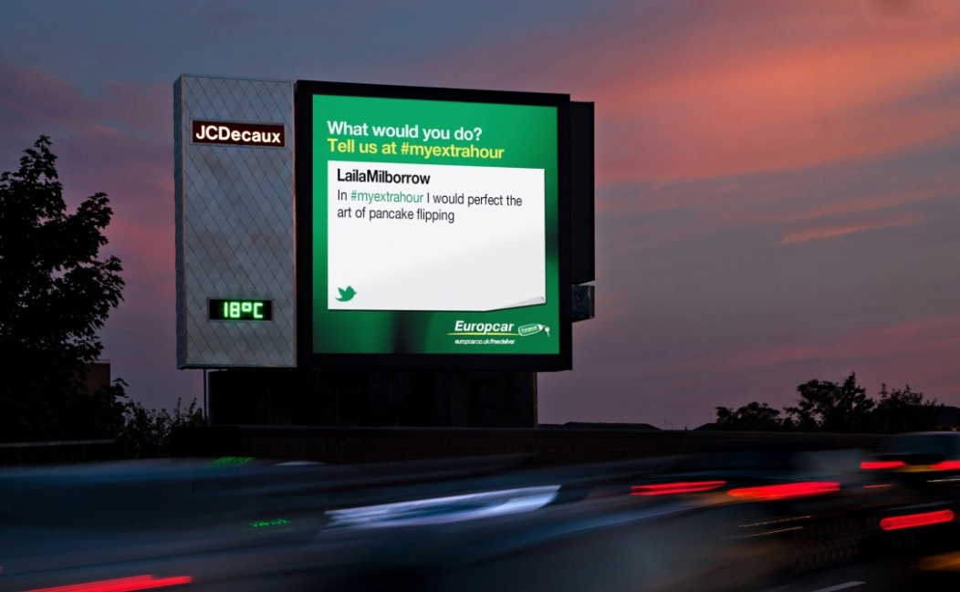
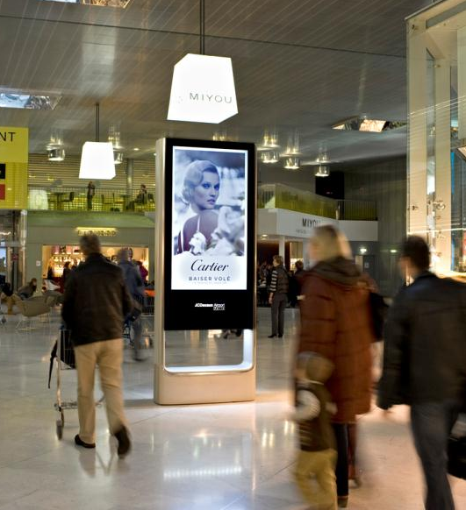
OUTDOOR INNOVATION
DIGITAL EVERYWHERE ?
Transport and indoor environments have progressively introduced Digital. Outdoor is beginning to follow in this stride.
Notes:
12 500 écrans : chiffres à fin 2012
Indoor : une audience captive, un environnement maîtrisé et sécurisé
Outdoor: des technologies plus coûteuses
Un axe de déploiement sélectif.
Marché du DOOH - Un marché poussé par les Etats-Unis devant la Chine et le Japon (top 3 = plus de 85% des dépenses DOOH)
Une tendance à l’accélération pour 2012 : +19,2% de recettes publicitaires DOOH attendus dans le monde (Source : Institut américain PQ media ‐2012‐2016 Digital Out of Home Media forecast)

Slide 50
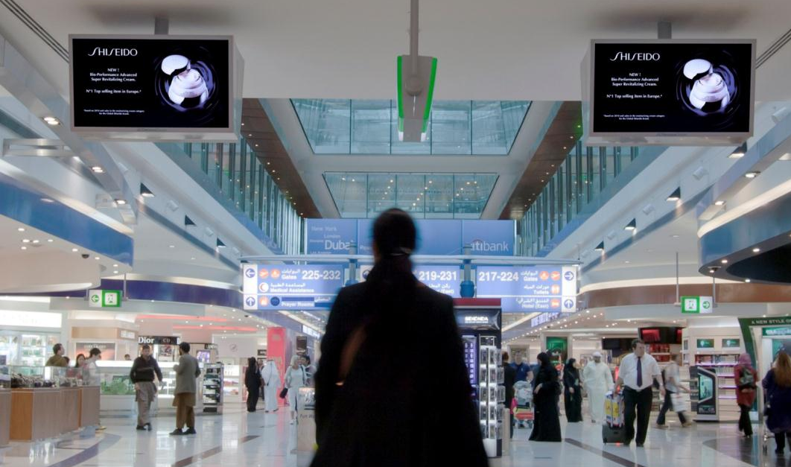

4 KEY ASSETS OF DIGITAL FOR BRANDS
Research plays a key role when introducing innovations : from measuring consumer acceptance to ad effectiveness.
Maximised Impact
Enhanced Brand Recall
Highly Popular Media
Outstanding Added-Value
Shiseido, Dubai Airport
Source: Digital Airport Stories 2012, a JCDecaux study
through 600 frequent flyers interviewed in Paris CDG & Orly Airports.
Notes:
50
Real time capabilities
Brand message at the right time,
Immersive brand experience

Slide 51
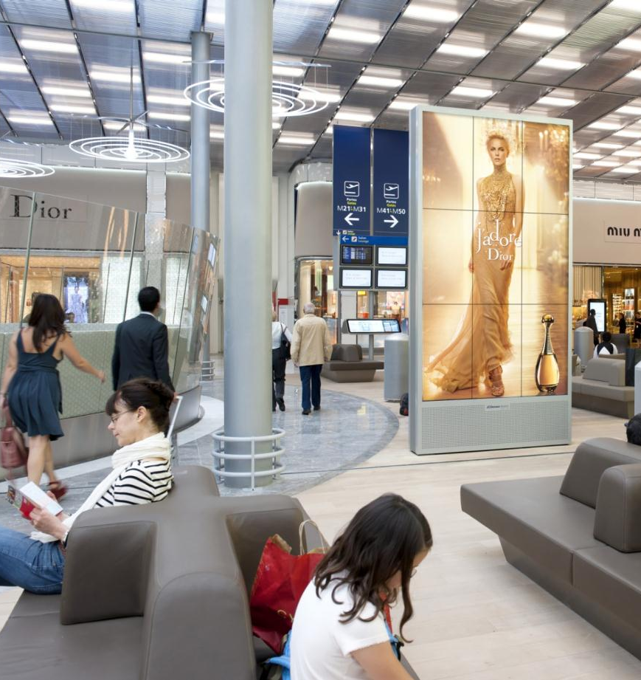

A HIGH LEVEL OF DIGITAL ACCEPTANCE
BY PASSENGERS IN AIRPORTS
Digital displays are:
92%
Aesthetic
92%
Visible
84%
Eye-catching
79%
Innovative
Dior, Paris CDG Airport
Notes:
51

Slide 52
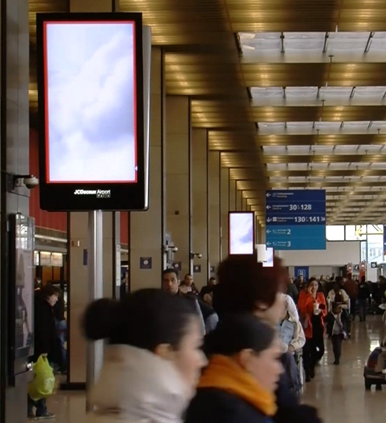
…THAT TRANSLATES INTO POSITIVE EFFECTS FOR BRAND COMMUNICATIONS
72%
remember seeing digital screens
82%
Like digital out-of-home ads
76%
Think it’s an original way to
discover brands
Source: Digital Airport Stories 2012, a JCDecaux study
through 600 frequent flyers interviewed in Paris CDG & Orly Airports.
Notes:
52

Slide 53

…THAT TRANSLATES INTO POSITIVE EFFECTS FOR BRAND COMMUNICATIONS
72%
remember seeing digital screens
82%
Like digital out-of-home ads
76%
Think it’s an original way to
discover brands
Source: Digital Airport Stories 2012, a JCDecaux study
through 600 frequent flyers interviewed in Paris CDG & Orly Airports.
Notes:
53
53

Slide 54
OUTDOOR INNOVATION
2 DRIVERS FOR THE FUTURE
Outdoor will strongly benefit from the digital revolution, opening new opportunities to make our media even more strategic for brands.
digital
interactivity
Estée Lauder, Singapore Changi Airport
Notes:
Out-Of-Home, among which airports, will strongly benefit from the digital revolution
Far from stifling / diminishing our media, digital and mobile represent exciting opportunities.
Two key drivers will reinforce our media and make it more engaging in the coming years.
Digital, of course, and some Transport environments are already mainly digital – it’s the case in some airports like Aéroports de Paris, or metro stations in Shanghai…
Interactivity, to make advertising messages even richer, to add another dimension, to enable consumers to engage with brands.
NEXT SLIDE : the many assets of digital

Slide 55

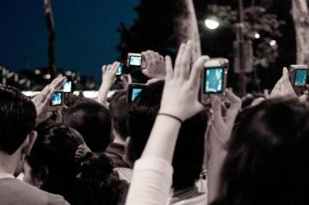
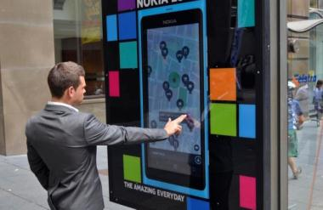
OUR ENVIRONMENTS ARE QUICKLY BECOMING CONNECTED
Interactivity opens up new opportunities for « augmented » Outdoor campaings.
3
Major challenges going forward
The right Technologies at the right time
The best, high-quality Contents & Services
To develop consumer Usage

Slide 56





INTERACTIVITY : REAL CONSUMER EXPECTATIONS BUT FEW USES TO DATE
In airports worldwide…
83%
Want more interactive screens
66%
Want to download entertainment or special offers on their smartphones
Source: JCDecaux Airport Stories World 2012 research
Notes:
Interactivity is a growing expectation from brands because it’s a way to build brand experience.
It’s also an expectation from frequent flyers in international airports – they want to touch, transform, play with brands in a surprising and exciting way – the opportunity to live a unique moment with a brand.
It isn’t so much a matter of technology…
- there are many ways to achieve interaction : touchscreens; mouvement, Augmented Reality, by mobile scanning with a smartphone etc
- and it can also take on much more « low tech » aspects through innovative campaigns and brand exhibits.
… Interactivity is all about strengthening consumer engagement in a general context in which consumers are harder to reach.
NEXT SLIDE : interaction via smartphones is another opportunity

Slide 57


INTERACTIVITY :
A FIRST FULL-SCALE OUTDOOR NFC TRIAL
JCDecaux UK launched a city-wide interactive campaign trial during 4 weeks in 2012
Over 300 bus shelters and poster sites were fully interactive
Direct engagement with brands via an NFC or QR Code link to their smartphone
13 clients tested real interactive content
6,000 interactions (10% of which with NFC)
78% of users enjoyed interacting with the brands
Notes:
Interactivity mediated by smartphones creates an intimate and personalized dialogue.
There are many possible technologies : image recognition, QR codes and tomorrow NFC and other innovations to come.
The crux of this type of interactivity is to build an attractive message that will engage consumers enough so that they will make the effort to enter a dialogue with a brand.
Brands need to be generous and offer exclusive and exciting contents to consumers, to make it worth their effort. Instant wins, promotions, exclusive videos, goodies etc can engage consumers to reach out to the brand.
It is an exciting perspective but the real innovation is that interactivity will contribute to further enhancing brand interactions in the real world.
The challenge for brands will be to continue delivering exceptional real-life brand and shopping experiences so that they remain superior to the virtual experience. And it’s the case when you look at the way shops have evolved recently in airports.
NEXT SLIDE : conclusion

Slide 58


"AUGMENTED" OUTDOOR TO DEVELOP
TRULY ENGAGING BRAND EXPERIENCES
Touchscreens, interaction via smartphones… rapidly evolving technologies and usage will open the way to unequalled brand presence in all urban environements.
Interaction
& dialogue
Transactions on the move

Slide 59

CONCLUSION

Slide 60



CONCLUSION
Research and innovation are key drivers for Outdoor in an increasingly complex media environment, to :
Anticipate
Understand
Promote
Create
… the future of our media
Notes:
It is our role to help advertisers in their decision-making process to ensure the best campaigns using the best creative, reach and engage with the right consumers.

Slide 61
OUTDOOR RESEARCH AND INNOVATION, THE KEY FOR THE FUTURE
Albert Asséraf
EVP Strategy, Research & Marketing
JCDecaux France
Kiev - May 22, 2013

